Slide 1


Full Stack Web Development

Slide 2
Our Agenda
Server Request
Coding
HTML
2

Slide 3
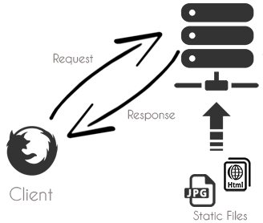
Server Request

Slide 4
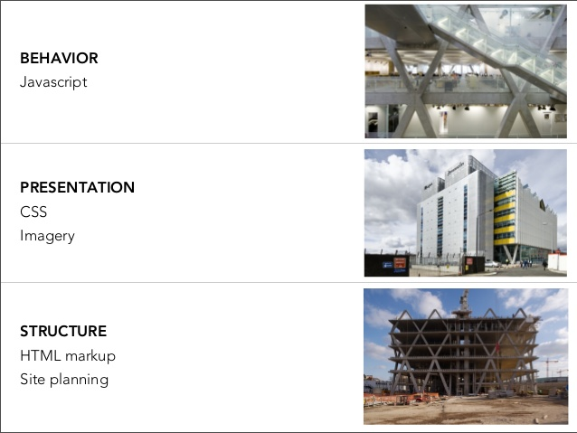
JavaScript
CSS
HTML

Slide 5
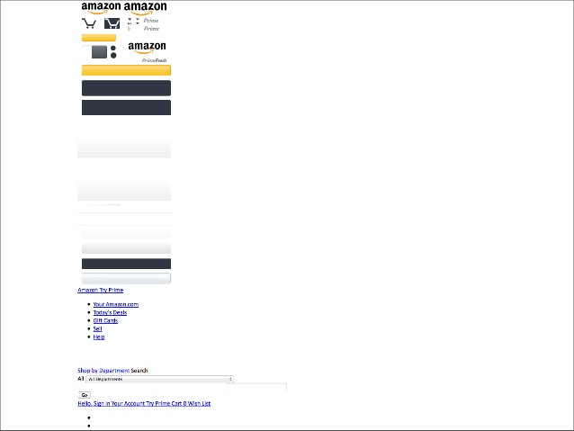

Slide 6
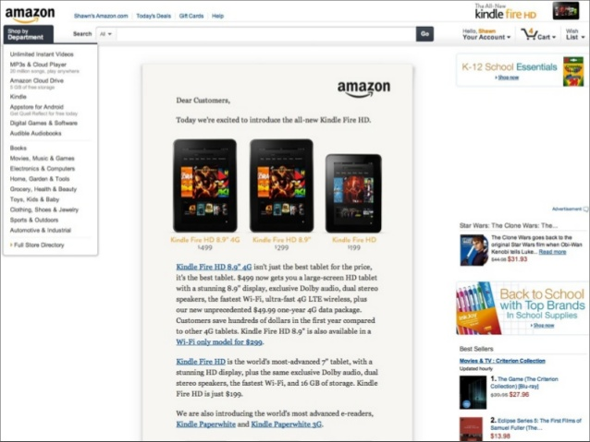

Slide 7


Slide 8


Slide 9
Get In Touch
Pro.ahmedelnemr@gmail.com
0100 52 967 53
facebook.com/deva7med
9

Slide 10
Good Day :D

